Slide 1
Bad or not prediction hmelq.csv

Slide 2
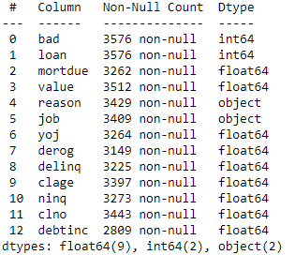
Data : (3576 * 13)
Data after deleting missing
values: (2018 * 13 )
Missed values (orani): 0.45 %
Bad (0)(Paid): 1840 (0.912)
Bad (1) : 178 (0.0882)

Slide 3
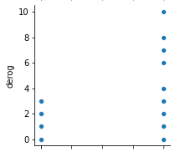
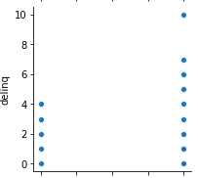
Derog (pairplot)
Delinq
Derog > 3 => verme
Delinq > 4 => verme

Slide 4
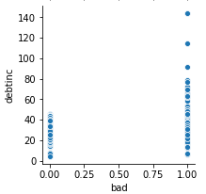
debtinc
debtinc > 48 => verme

Slide 5
Correlation:
Value && mortdue (0.84) benziyor

